Slide 1

Project Presentation on
PREDICTION OF CHRONIC KIDNEY DISEASE USING MACHINE LEARNING
By
ARAVA ANANTHA RAO
Reg. No : 21131F0001
IV semester M.C.A
Under the guidance of
Mr. P .V .V. R Chandra Sekhar
Assistant professor
DEPARTMENT OF COMPUTER APPLICATIONS
GAYATRI VIDYA PARISHAD COLLEGE OF
ENGINEERING (AUTONOMOUS)
VISAKHAPATNAM – 530048
2021-23
1

Slide 2
Status of CRC
CRC | Status | Date
CRC | Completed | 28/06/23
2

Slide 3
OUTLINES OF THE PRESENTATION
Acronyms
Abstract
Literature Review
Problem Statement
Introduction
Existing System
Proposed System
System Requirements and Specifications
Algorithms
UML Diagrams and Architecure
Sample Code
Output Screens
Conclusion
References
Future Scope
3

Slide 4
ACRONYMS
CKD : CHRONIC KIDNEY DISEASE
ESRD : END STAGE OF RENAL DISEASE
GUI : GRAPHICAL USER INTERFACE
UML : UNIFIED MODELING LANGUAGE
4

Slide 5
ABSTRACT
Through a detailed study of several chronic medical conditions, technological innovation has had an immense impact on health. The detection of such disorders at early stages is particularly crucial. It is challenging for clinicians to manually diagnose the disorders precisely. Diabetes and high blood pressure are the primary causes of Chronic Kidney Disease. People with chronic kidney disease are more likely to die early.
Therefore, the system aims to develop an intelligent model that classifies patients into three groups: “Severe CKD”, “Mild-Mod CKD”, and “End Stage of Renal Disease (ESRD)”. This model facilitates doctor’s efficient management of multiple patients and faster diagnoses.
In this study, the prediction of “Severe CKD”, “Mild-Mod CKD” and “ESRD” conditions is performed using ‘K-Nearest Neighbors (KNN)’ and ‘Decision Tree’ algorithms.
5

Slide 6
LITERATURE REVIEW
[1] Using data analytics, Gunarathneetal completed a performance evaluation of machine learning classification techniques for chronic kidney disease forecasting and classification in 2017. Predicting CKD and Non-CKD in a patient is their area of research. Multiclass - Decision Forests, Jungle, Logistic Regression, and KNN are some of the classification techniques that have been employed. Utilising Microsoft Azure Machine Learning Studio, the results were attained.
[2] A system developed by J. Snegha in 2020 makes use of the Random Forest algorithm and Back Propagation Neural Network, among other data mining approaches. As they evaluate the two algorithms, they find that the Back Propagation approach produces the best results since it makes use of the Feed Forward Neural Network, a supervised learning network.
[3] J. Van Eiyck, J. Remon, F. Giza, G. Mefroidt, M. Bruynighe, G. Van den Berghe, K. U. Leuven, and others used data mining methods using machine learning (classification and regression tasks) and the Gaussian process for predicting renal damage after elective heart surgery.
6

Slide 7
PROBLEM STATEMENT
Millions of individuals worldwide suffer from chronic kidney disease (CKD), which is a widespread and serious health concern. Early identification of CKD can help prevent or postpone the progression of the disease and lower the risk of consequences, such as renal failure. However, traditional diagnostic methods for CKD are often costly and time-consuming, making them impractical for widespread use.
7

Slide 8
INTRODUCTION
Humans having chronic kidney disease have been reported to have damaged kidneys that are unable to function properly. Globally, chronic kidney disease is a severe public health issue that affects millions of people. Early diagnosis and treatment of (CKD) may greatly enhance patient outcomes, avoid complications, and save medical expenses.
Kidney disease, including CKD, is found to impact more than 800 million individuals worldwide. For someone to be identified as having CKD, two sets of samples must be collected at least 90 days apart. CKD can worsen over time, and both kidneys may eventually quit working. CKD is frequently associated with other diseases.
8

Slide 9
EXISTING SYSTEM
Currently, the diagnosis and prediction of chronic kidney disease (CKD) rely on traditional diagnostic methods such as blood tests, urine tests, and imaging tests. These tests are often costly and time-consuming, making them impractical for widespread use. Additionally, these tests may not always detect CKD in its early stages.
Lack of nephrologists or general doctors makes it difficult for many local hospitals and clinics to diagnose symptoms. There are various machine learning-based models for predicting CKD now available, however they are often constrained by the quantity and quality of the training data. Moreover, these models may use complex algorithms that are difficult to interpret and may not be suitable for clinical environments.
DISADVANTAGES
Time efficiency is high
Don’t know which algorithm can be give better results
9

Slide 10
PROPOSED SYSTEM
In the proposed system, we identify the best combinations that can execute, compare the performance and accuracy of the algorithm, and provide a better accuracy and detection rate. Finally, we demonstrate that the 'Decision Tree Algorithm' successfully separates the clinical data of CKD from non-CKD with an overall accuracy of 86%.
ADVANTAGES
Provides fast operation.
Low cost expense than old system.
Provides user friendly interface.
Reducing Time efficiency
10

Slide 11
FUNCTIONAL REQUIREMENTS
DATA COLLECTION:
Collect a large dataset of clinical data from kidney disease patients.
MODEL TRAINING AND EVOLUTION:
The system should allow the training of the models using a labeled dataset, providing options to adjust the
parameters.
USABILITY:
The system should have a user-friendly interface, allowing easy navigation.
SECURITY AND PRIVACY:
The system should integrate adequate security mechanisms to secure patient’s data.
11

Slide 12
NON FUNCTIONAL REQUIREMENTS
PERFORMANCE:
The system should be capable of handling big datasets effectively, ensuring minimum
processing time for training and prediction.
RELIABILITY:
The system should provide a reliable environment for the user to ensure that predictions are
consistent .
AVAILABILITY:
The system will be available by 24/7.
12

Slide 13
MINIMUM HARDWARE REQUIREMENTS:
Processor
RAM
Hard Disk
Keyboard
: Intel i3
: 8 GB
: 128 GB
: Standard Keyboard
MINIMUM SOFTWARE REQUIREMENTS:
Front End : Html, CSS, Flask
Programming Language : Python 3.7
Platform : Visual Studio Code
OS : Windows 7
13

Slide 14
K-NEAREST NEIGHBOUR (KNN) :
K-nearest neighbours (KNN) algorithm is a supervised algorithm which can be used for both classification as well as
regression predictive problems. However, classification prediction problems are where it is most frequently utilised.
K-NN makes no assumptions about the underlying data because it is a non-parametric approach.
As a result of storing the training dataset rather than instantly learning from it, the method is also referred to as a lazy learner.
Instead, it performs an action while classifying data by using the dataset.
STEPS :
ALGORITHMS
Choose the k-number of neighbours.
Find the neighbours' euclidian distances using k.
Determine the k nearest neighbours in accordance with the calculation.
Count the number of data points in each category among the k neighbours.
Assign the new data points to that category for which the number of the neighbor is maximum.
14

Slide 15
DECISION TREE:
Decision Tree is a supervised learning technique that may be used for both classification and regression issues, although usually utilised for addressing classification problems. It is a tree structured classifier, where internal nodes represent the feature of a dataset, branches represent the decision rules and each leaf node represents the conclusion.
STEPS:
Identify the tree's root node.
Calculate the gini index for the current node.
For each attribute, calculate the gini index after splitting.
Select the attribute that results in lowest gini index
Execute the split.
Continue splitting until stopping condition in met.
Finish up the decision tree.
15

Slide 16
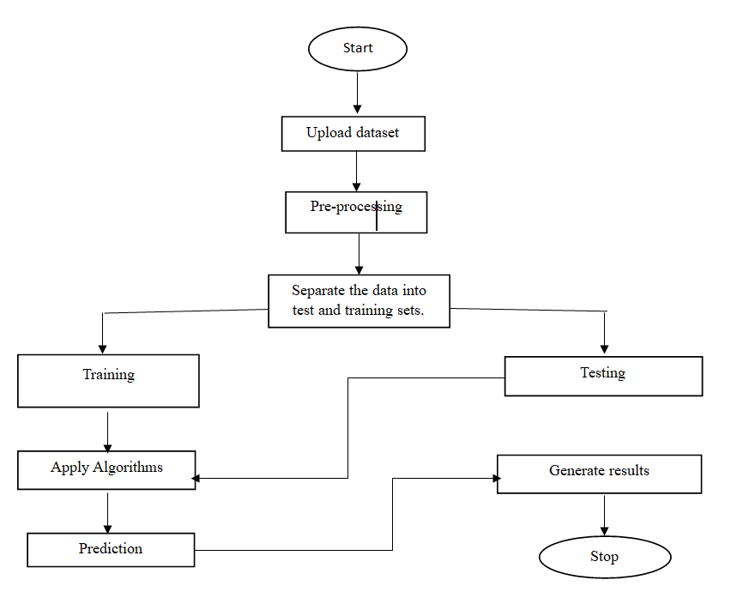
ARCHITECTURE
16

Slide 17
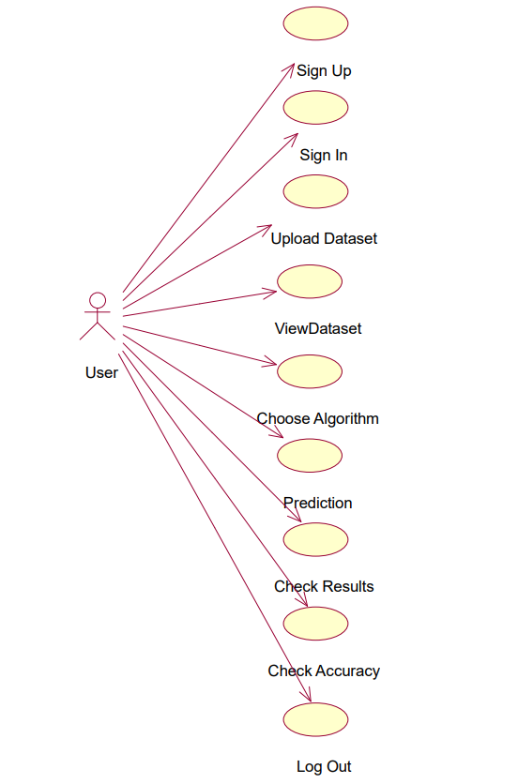
USECASE DIAGRAM
Fig 1: Usecase Diagram
17

Slide 18
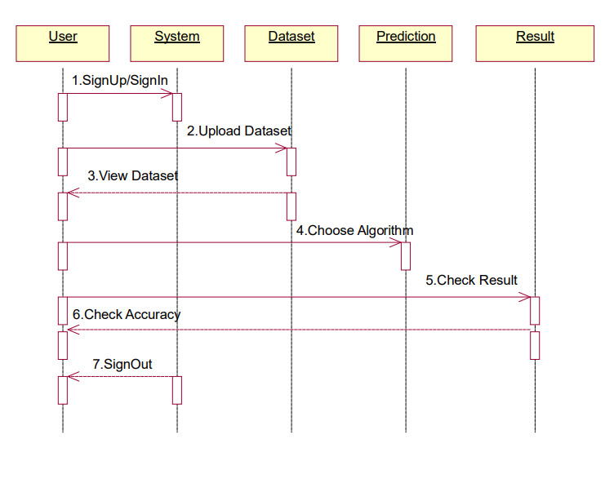
SEQUENCE DIAGRAM
Fig 3: Sequence Diagram
18

Slide 19
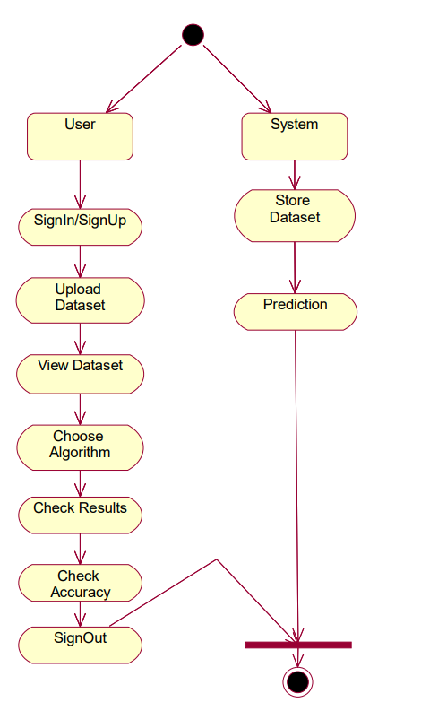
ACTIVITY DIAGRAM
Fig 6: Activity Diagram
19

Slide 20
SAMPLE CODE
@app.route('/upload', methods=['GET', 'POST'])
def upload():
if request.method == 'POST':
# check if the post request has the file part
if 'file' not in request.files:
return redirect(request.url)
file = request.files['file']
if file.filename == '':
return redirect(request.url)
if file:
# read the uploaded file into a pandas dataframe
df = pd.read_csv(file)
# render the view.html template with the dataframe
return render_template('view.html', table=df.to_html(index=False))
return redirect(request.url)
app = Flask(__name__)
users=[]
@app.route('/')
def home():
return render_template('index.html')
@app.route('/second')
def second():
return render_template('sign.html')
@app.route('/third')
def third():
return render_template('aboutus.html')
20

Slide 21
SAMPLE CODE
@app.route('/result', methods=['POST'])
def make_prediction():
patient_details=[]
# Get user input from the HTML form
name = request.form['name']
age = int(request.form['age'])
weight = float(request.form['weight'])
sg = float(request.form['sg'])
alb = float(request.form['alb'])
egfr = float(request.form['egfr'])
wbc = float(request.form['wbc'])
algorithm = request.form['algorithm']
# Create a list from the user input
patient_details.append([age, weight, sg, alb, egfr, wbc])
if algorithm == 'knn':
prediction = predict(train_features, train_target, patient_details, k)[0]
if prediction == 0:
prediction_text = "Mild-Mod CKD"
elif prediction == 1:
prediction_text = "ESRD"
elif prediction == 2:
prediction_text = "Severe CKD"
return render_template('result.html', name=name, age=age, weight=weight, sg=sg, alb=alb, egfr=egfr, wbc=wbc, prediction=prediction_text)
21

Slide 22
KNN CODE:
import pandas as pd
# Load the dataset using pandas
data = pd.read_csv('kidney.csv')
# Split the data into features and target
features = data.iloc[:, :-1].values
target = data.iloc[:, -1].values
# Split the dataset into training and test sets
split_ratio = 0.7
split_index = int(split_ratio * len(features))
train_features = features[:split_index]
train_target = target[:split_index]
test_features = features[split_index:]
test_target = target[split_index:]
k =2
def eucledian_dist(x1, x2):
dist= 0
for i in range(len(x1)):
dist += (x1[i] - x2[i])**2
return dist**0.5
def get_neighbors(train_data, train_labels, test_instance, k):
distances = []
for i in range(len(train_data)):
dist = eucledian_dist(test_instance, train_data[i])
dist.append((train_labels[i], dist))
dist.sort(key=lambda x: x[1])
28
neighbors = [dist[i][0] for i in range(k)]
return neighbors
def pred(train_data, train_labels, test_data, k):
pred = []
for i in range(len(test_data)):
neighbors =
22

Slide 23
DECISION TREE CODE:
import pandas as pd
import numpy as np
class DecisionNode:
def __init__(self, feature=None, threshold=None, left=None, right=None, value=None):
self.feature = feature
self.threshold = threshold
self.left = left
self.right = right
self.value = value
def is_leaf_node(self):
return self.value is not None
class DecisionTree:
def __init__(self, max_depth=None):
self.max_depth = max_depth
def fit(self, X, y):
self.n_classes_ = len(set(y))
self.tree_ = self._grow_tree(X, y)
def predict1(self, X):
return [self._predict(inputs) for inputs in X]
def _best_split(self, X, y):
m = y.size
if m <= 1:
return None, None
num_parent = [np.sum(y == c) for c in range(self.n_classes_)]
best_gini = 1.0 - sum((n / m) ** 2 for n in num_parent)
best_idx, best_thr = None, None
for idx in range(X.shape[1]):
23

Slide 24
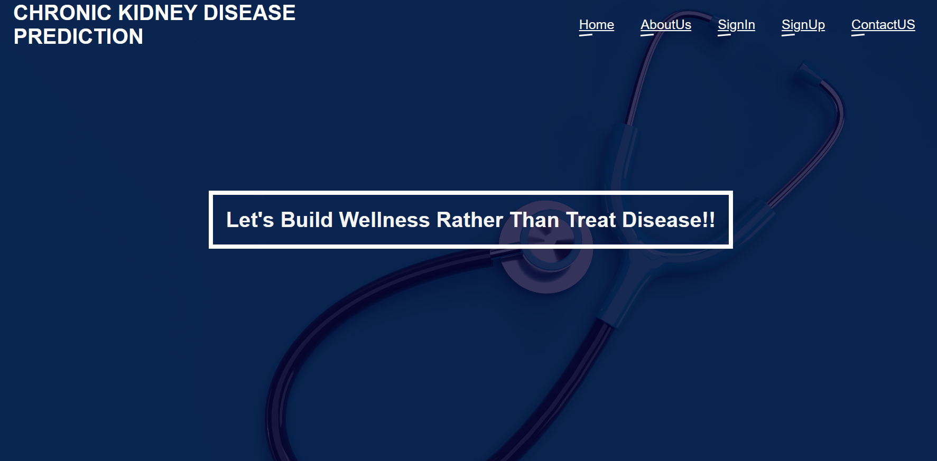
OUTPUT SCREENS
HOME SCREEN
24

Slide 25
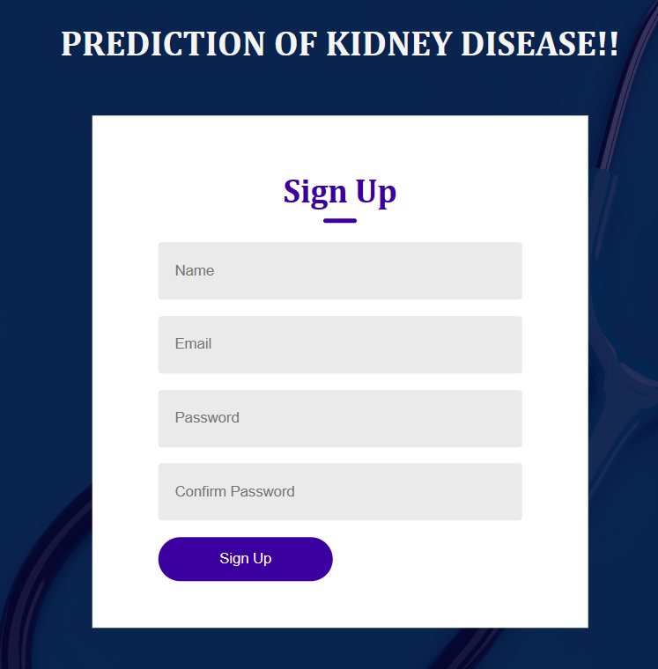
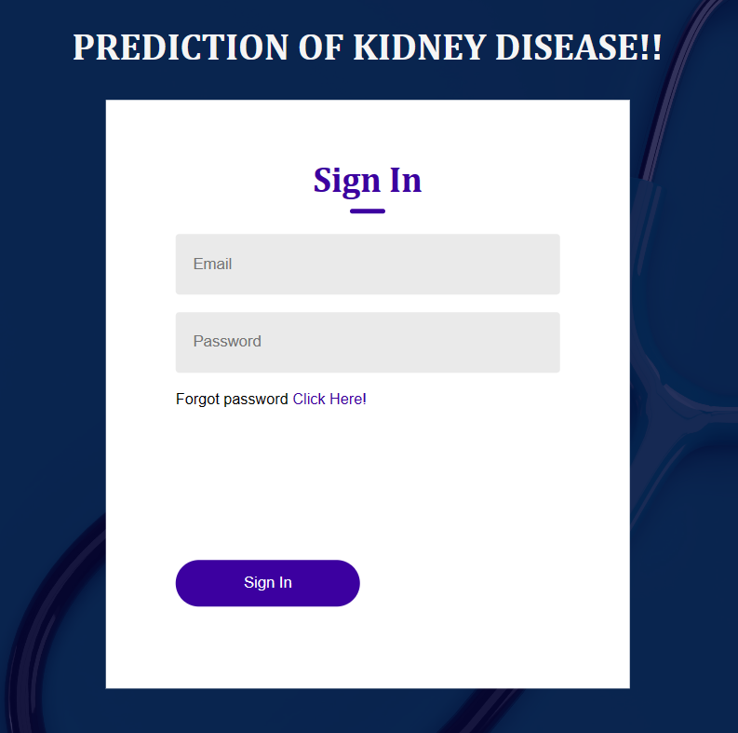
SIGN UP/ SIGN IN PAGE
25

Slide 26
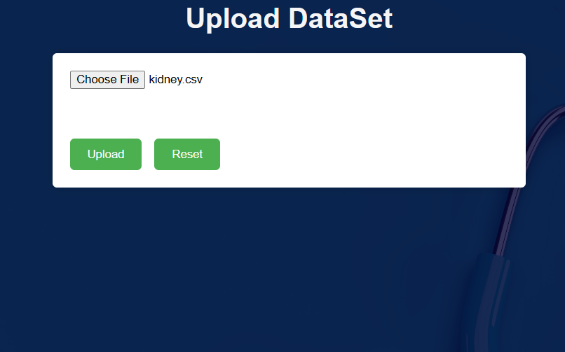
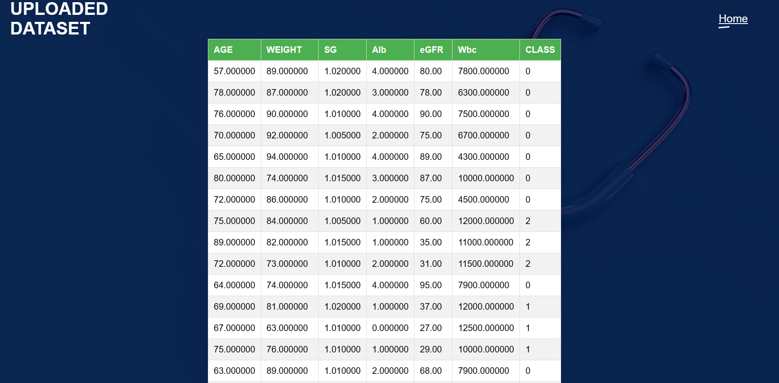
UPLOAD AND VIEW DATASET PAGE
26

Slide 27
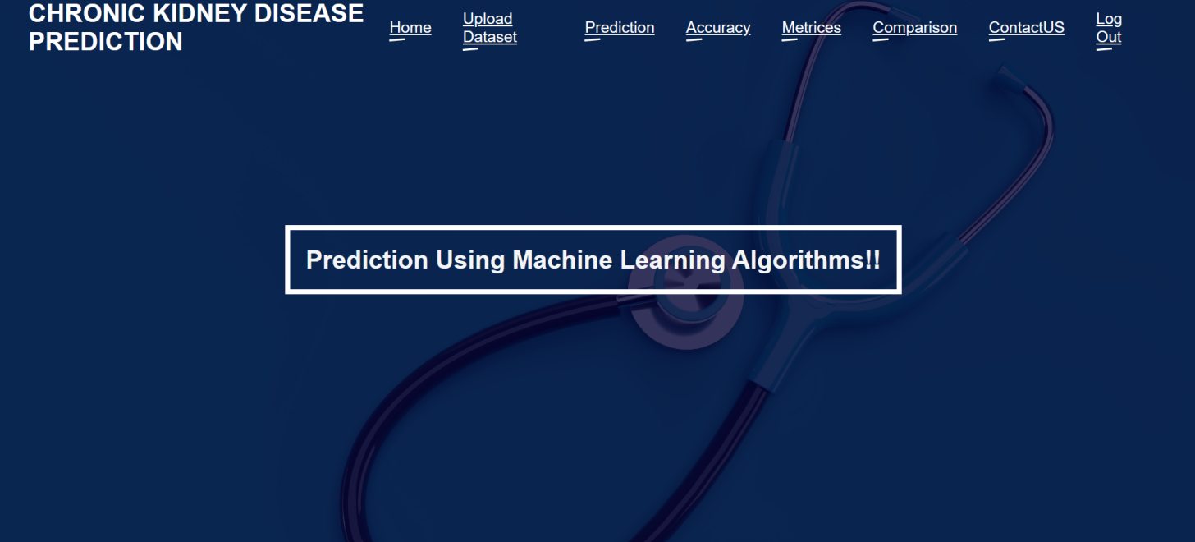
MAIN PAGE
27

Slide 28
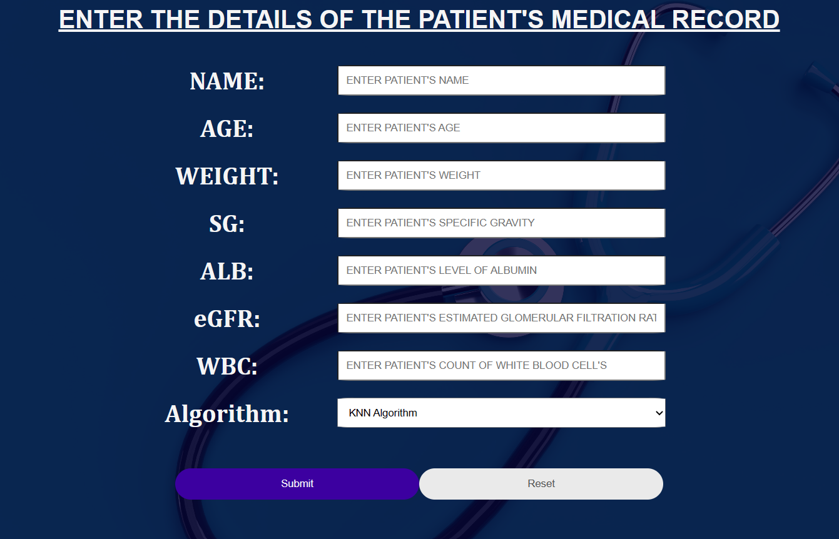
PREDICTION PAGE
28

Slide 29
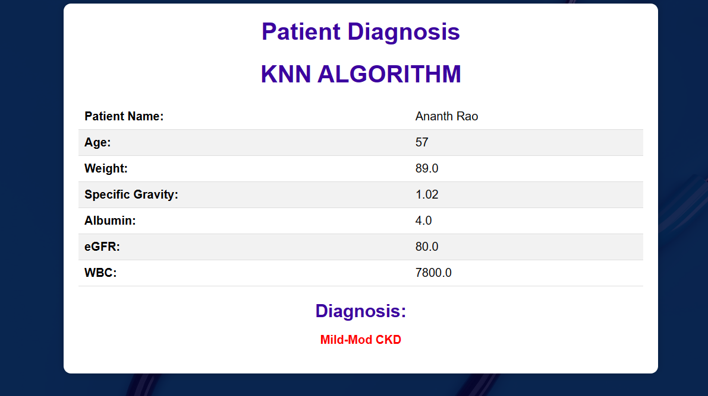
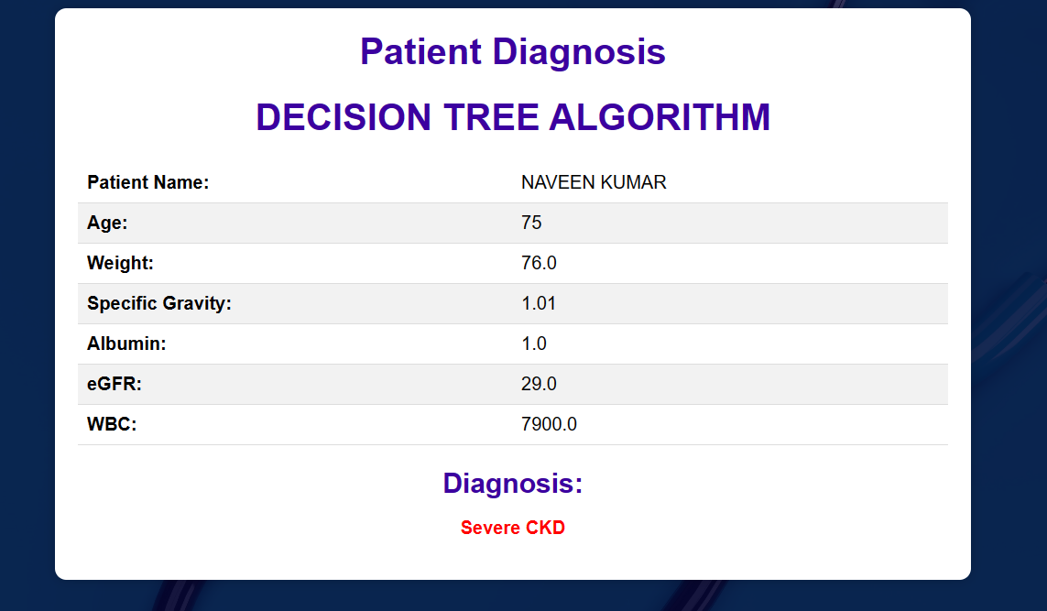
RESULT SCREEN
29

Slide 30
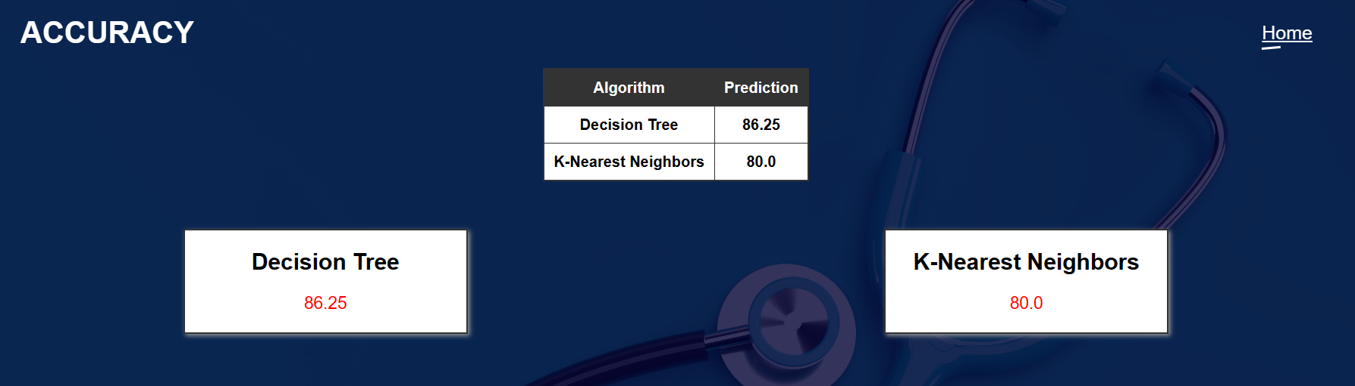
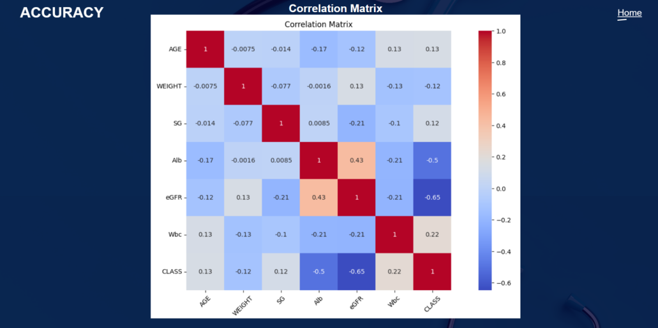
ACCURACY PAGE
30

Slide 31
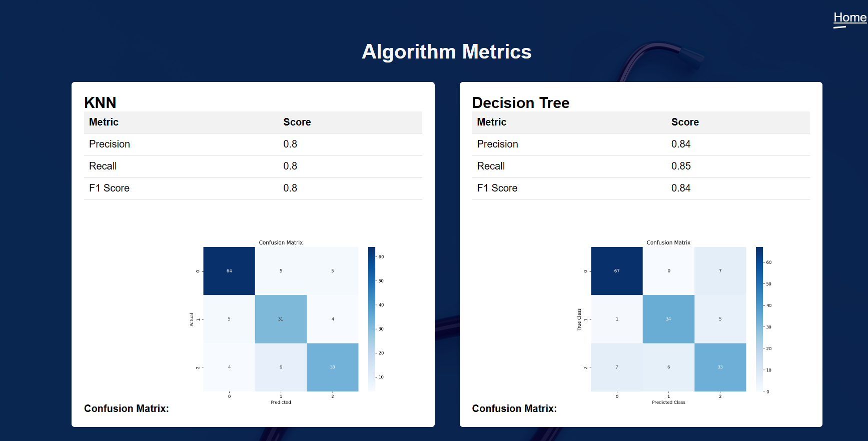
METRICES PAGE
31

Slide 32
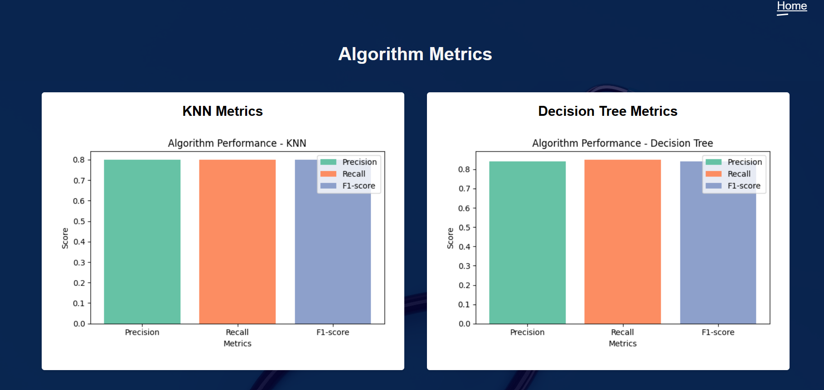
METRICES GRAPH PAGE
32

Slide 33
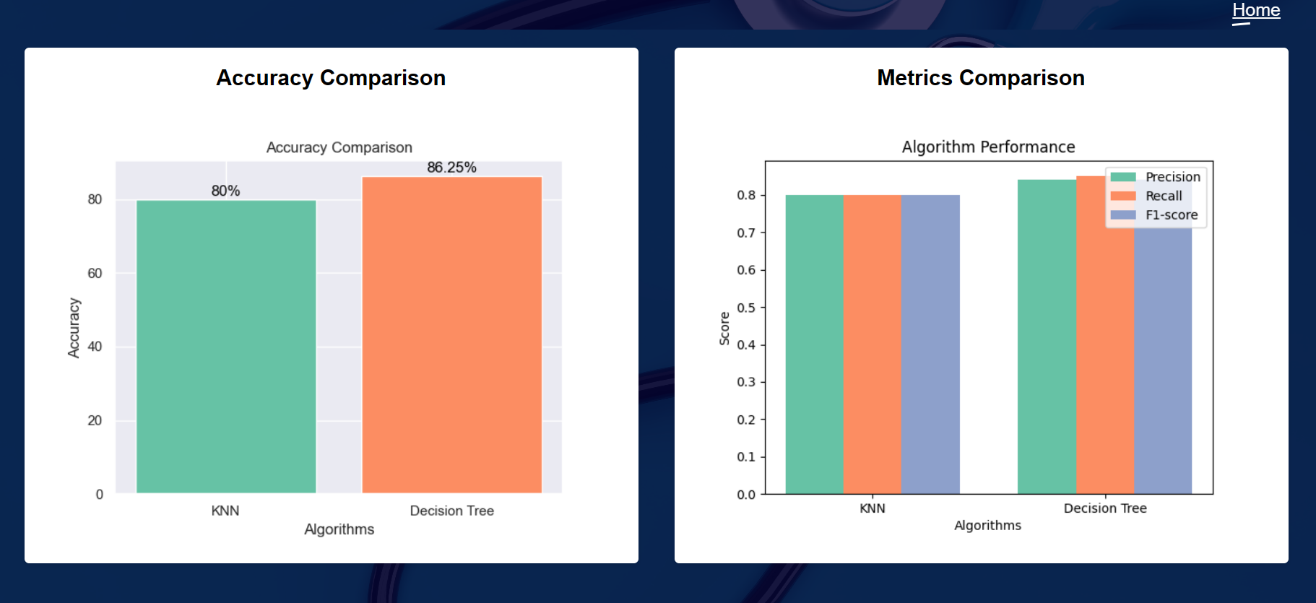
ALGORITHM COMPARISION GRAPH PAGE:
33

Slide 34
CONCLUSION
In conclusion, the system is aimed to predict ‘CHRONIC KIDNEY DISEASE’ from the kidney patient’s dataset using machine learning algorithms namely ‘KNN’ and ‘Decision Tree’. Each of this algorithm demonstrated promising results in prediction. However the performance varies among the algorithms. The system utilized the concept of ‘Machine Learning Algorithms’ in prediction of chronic kidney disease and paved a way for advancement of healthcare analytics.
34

Slide 35
REFERENCES
[1] B. Khan, R. Naseem, F. Muhammad, G. Abbas, and S. Kim, ‘‘An empirical evaluation of machine learning techniques for chronic kidney disease prophecy,’’ IEEE Access, vol. 8, pp. 55012–55022, 2020
[2] S. Vallabhajosyula, L. Ya’Qoub, V. Kumar, D. Verghese, A. V. Subramaniam, S. H. Patlolla, V. K. Desai, P. R. Sundaragiri, W. Cheungpasitporn, A. J. Deshmukh, K. Kashani, and G. W. Barsness, ‘‘Contemporary national outcomes of acute myocardial infarctioncardiogenic shock in patients with prior chronic kidney disease and end-stage renal disease,’’ J. Clin. Med., vol. 9, no. 11, p. 3702, Nov. 2020.
[3] N. Tangri et al., ‘‘Multinational assessment of accuracy of equations for predicting risk of kidney failure: A meta-analysis,’’ J. Amer. Med. Assoc., vol. 315, no. 2, pp. 164–174, 2016.
[4] O. Viktorsdottir, R. Palsson, M. B. Andresdottir, T. Aspelund, V. Gudnason, and O. S. Indridason, ‘‘Prevalence of chronic kidney disease based on estimated glomerular filtration rate and proteinuria in Icelandic adults,’’ Nephrol. Dialysis Transplantation, vol. 20, no. 9, pp. 1799–1807, Sep. 2005.
35

Slide 36
FUTURE SCOPE
With potential improvements in a number of domains, the prediction of chronic kidney disease using machine learning has a promising future. Here are some noteworthy details to investigate in the future:
1. Enhanced Accuracy
2. Feature Selection and Extraction
3. Real-time Monitoring
4. Personalized Treatment
5. Integration of Multiple Data Sources
6. Collaborative Research and Data Sharing
Overall, the potential for improving diagnosis, treatment, and patient outcomes from the prediction of chronic kidney disease using machine learning is enormous. Future healthcare interventions may be more individualized and successful as a result of ongoing study and innovation in this area.
36

Slide 37
THANK YOU
37

